Slide 1

PREDICT AD CLICKS

Slide 2
Description of the dataset:
ID: Unique ID of the record
datetime: Timestamp of the ad click
siteid: Website ID
offerid: Offer ID (commission-based offers)
category: Offer category
merchant: Seller ID
countrycode: Country where affiliates reach is present
browserid: Browser used
devid: Device used
click: Target variable

Slide 3
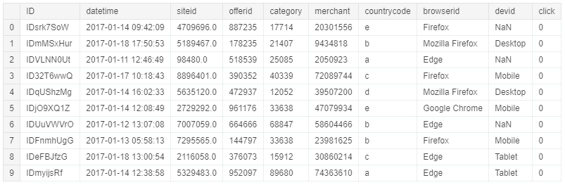
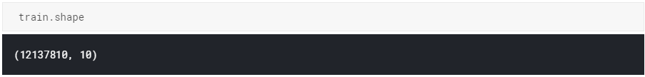
First 10 rows:

Slide 4
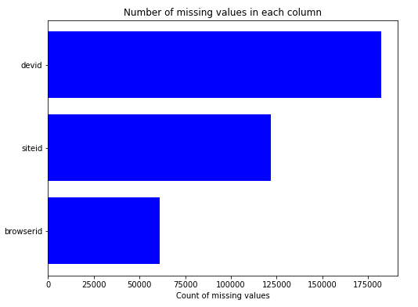
EDA on a sample of the dataset:
Computed missing values
Filled the missing values with the mode values

Slide 5
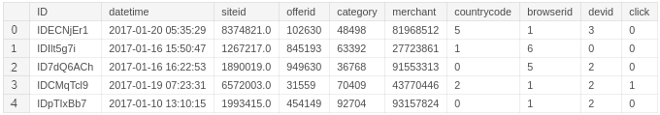
EDA on a sample of the dataset:
Encoded the categorical variables – countrycode, browserid, and devid using Label Encoding

Slide 6
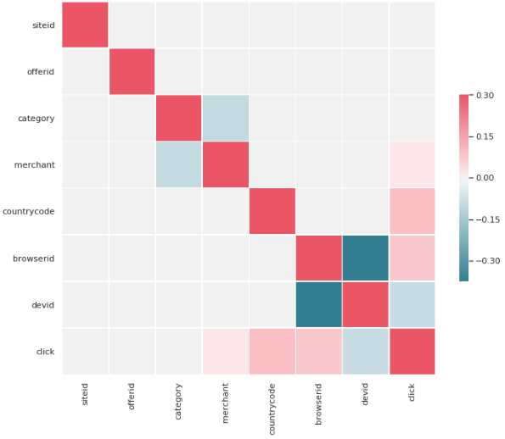
Correlation:

Slide 7
Appended new features to the dataset:
Divided the datetime feature into:
date
hour
minute
Created new features using Mean Encoding:
mean_siteid_enc
mean_offerid_enc

Slide 8
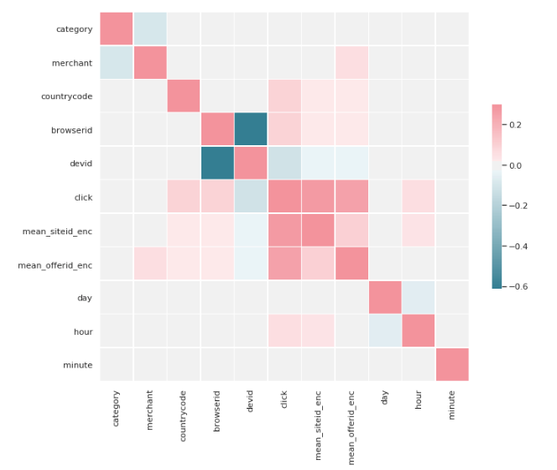
Correlation after adding new features:

Slide 9
Important features:
browserid
countrycode
hour
devid
mean_offerid_enc
mean_siteid_enc

Slide 10
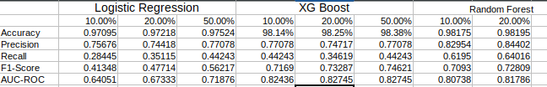
First-cut metrics of the models:

Slide 11
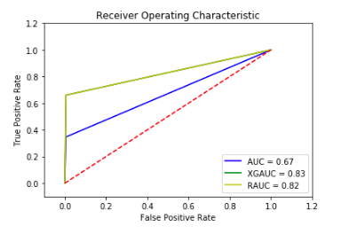
AUC:

Slide 12
Thank you

